Slide 1
covid -19 Forecasting and Prediction on INDIA
Omang Agarwal

Slide 2
The Goals:
Goals
Description
Goals:
Description
Daily New Corona Cases Forecast
Daily Deaths Prediction
Data Source: WHO
The forecast of New corona cases in India will help in determining the magnitude of the coronavirus pandemic in coming days. Which will help the central and state governments to embrace for the future challenges and prepare for it in order to make forecast fail. Daily death prediction will also help the central and state governments to judge their health care system and the arrangements made to cure coronavirus effected people. This will lead the health care system to optimize better for future cases.

Slide 3
Project Steps
Data Pre-processing & Visualization
Forecasting
Classification
Data Pre-processing
& Visualization
Forecasting
Classification
Through visualization the data appeared seasonal, multiplicative, and showing an upward trend which will lead us to use SAIRMA for forecasting.
Data would be analysed and visualized to gather insights of daily New cases and deaths in India.
Apply different classification algorithm to predict daily deaths based on forecasted cases.

Slide 4
Data Pre-processing & Visualization

Slide 5
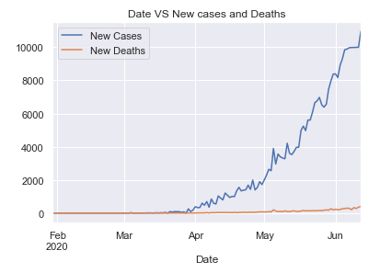
Key Observations
Daily Cases are showing an upward trend.
Daily Deaths are also showing an upward trend.

Slide 6
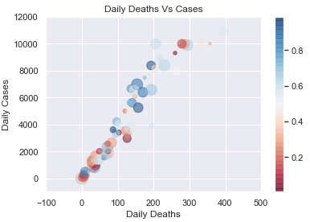
Key Observations
Data is ambiguous due to following factors:
    State gov. revising numbers of past dates.
    Daily increase in testing is directly propotional to number of new cases.
    Data do not follow any pattern except an upward trend.

Slide 7
Forecasting

Slide 8
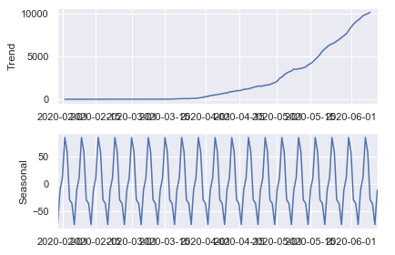
Checking the stationarity
Checking the seasonality of the time series
Augmented Dickey-Fuller Test:
ADF test statistic 4.103489
p-value 1.000000
# lags used 11.000000
# observations 123.000000
critical value (1%) -3.484667
critical value (5%) -2.885340
critical value (10%) -2.579463
Weak evidence against the null hypothesis
Fail to reject the null hypothesis
Data has a unit root and is non-stationary
As p value is >0.05 so the data is non-stationary
By: Seasonal Decompose method:
Data has a clear seasonality of 7days i.e. m = 7

Slide 9
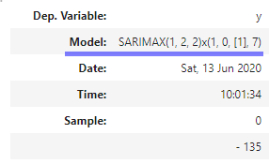
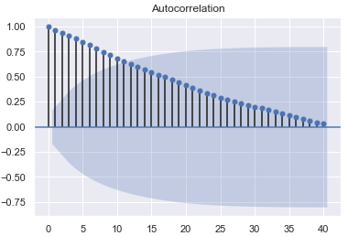
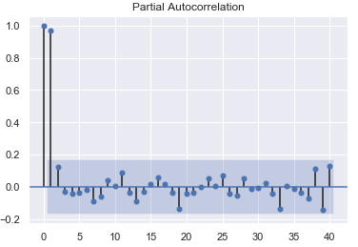
Getting p,q,d and P,Q,D components
Confirming p and q value by acf and pacf plots
acf plot
q = 2
By: auto_arima function of pmdarima library
As there is a seasonality we will use SARIMA model to forecast.
From the above report we got
Order = (1, 2, 2)
Seasonal_Order = (2, 0, [1], 7)
pacf plot
p = 1

Slide 10
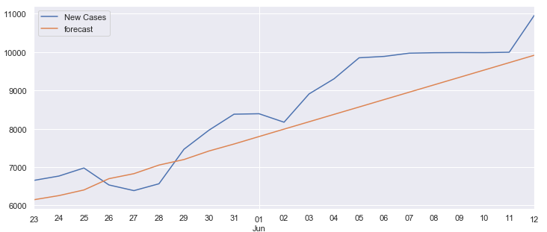
Training, testing and evaluation
Training was done on 85% of data and tested on further 15%
Model:
SARIMAX(train['New Cases'],order = (1,2,2), seasonal_
order =(1,0,[1],7))
Forecast: on 15% recent data
fit_test.predict(start = start, end = end, typ = 'levels').rename("forecast")
Evaluation:
RMSE Error = 706
Mean = 8528
So the RMSE value is in 1:12 ratio with the mean, which is pretty good.
Forecast on recent 15% test data

Slide 11
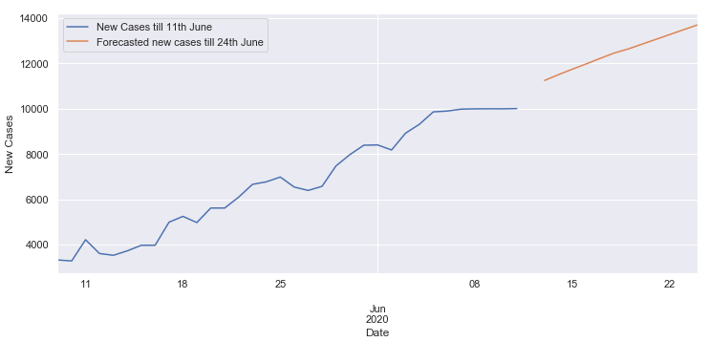
Forecasting by SARIMA
Final forecasting is done on overall data for the next 12 days. i.e. from 13th June 2020 to 24th June 2020
Model:
SARIMAX(covid_india['New Cases'],order = (1,2,2),seasonal_order=(1,0,[1],7))
Forecast:
fit_final.predict(start = len(covid_india), end = len(covid_india) +11, typ = 'levels').rename("Forecasted new cases till 24th June")
Forecasting

Slide 12
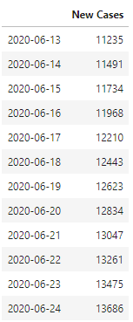
Forecasting by SARIMA Results:

Slide 13
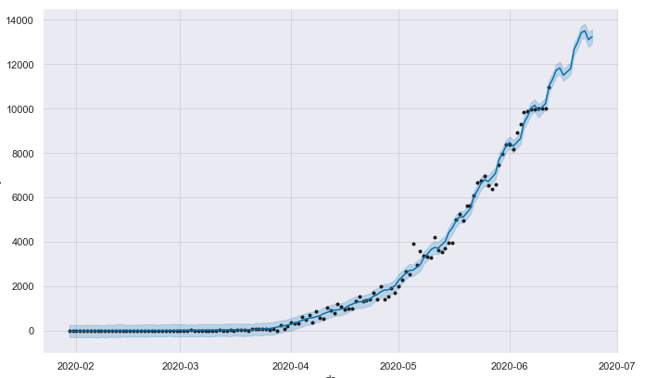
Forecasting by Facebook prophet library
Final forecasting is done on overall data for the next 12 days. i.e. from 13th June 2020 to 24th June 2020
Model:
Prophet(seasonality_mode='multiplicative')
Forecast:
future = m.make_future_dataframe(periods=12,freq = 'D')
m.predict(future)
We will take SARIMA forecasting forward for daily deaths predictions as prophet library has greater rmse error.
Forecasting

Slide 14
Prediction: Regression

Slide 15
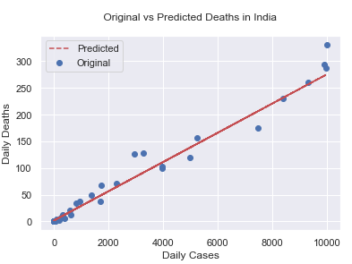
Linear Regression
As the data showing a trend and there are
no labels so we will 1st implement
Linear regression.
Train, test and evaluation:
X_train, X_test, y_train, y_test = t
rain_test_split(X, y, test_size=0.33, random_state=102)
Model:
model1=lr.fit(X_train,y_train)
Prediction:
y_lr=lr.predict(X_test)
Evaluation:
RMSE=14.5
R2 = 0.97

Slide 16
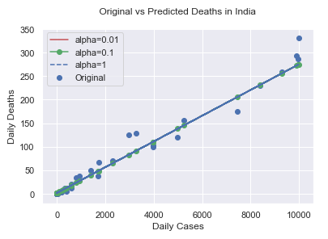
Ridge Regression
We will use different alpha values viz. 0.01,
0.1, and 1 to know the effect of regularization
over the prediction from linear regression.
Train, test and evaluation:
X_train, X_test, y_train, y_test = t
rain_test_split(X, y, test_size=0.33, random_state=102)
Model and prediction
model_r1 = Ridge(alpha=0.01)
model_r1.fit(X_train,y_train)
model_r2= Ridge(alpha=0.1)
model_r2.fit(X_train,y_train)
model_r3= Ridge(alpha=1)
model_r3.fit(X_train,y_train)

Slide 17
Evaluating accuracy score of Ridge and Linear Regression
Results:
Train and Test set score
LinearRegression()=93.0 %
LinearRegression()=97.0 %
Ridge(alpha=0.01)=93.0 %
Ridge(alpha=0.01)=97.0 %
Ridge(alpha=0.1)=93.0 %
Ridge(alpha=0.1)=97.0 %
Ridge(alpha=1)=93.0 %
Ridge(alpha=1)=97.0 %
Code:
print("Train and Test set score")
for i in [model1,model_r1,model_r2,model_r3]:
x= round(i.score(X_train,y_train)*100)
y=round(i.score(X_test,y_test)*100)
print(f"{i}={x}"" %")
print(f"{i}={y}"" %\n")
As it is evident from the above scores that using linear regression or
Ridge regression will give **similar results** so here I will prefer
linear regression for building my model.

Slide 18
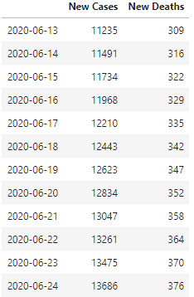
Final Prediction
covid_forecast['New Deaths'] = lr.predict(covid_forecast).astype(int)

Slide 19
Conclusions

Slide 20
Conclusions
Following are the key points drawn from this project:
Dataset provided was clean and normalized.
Seasonality and trend is there.
SARIMA is used for forecasting, as Facebook prophet library is providing poor rmse results.
SARIMA model achieved 95% accuracy in forecasting daily new cases of corona.
Linear Regression is used in place of ridge because there is no effect on the score after regularization.
Linear Regression achieved 97% accuracy in predicting daily deaths due to corona virus.

